Slide 1
Marketplace for GYM
User Interface
Group - 3

Slide 2
Group Members
Name | ID
Muhammad Zawad Mahmud | 1931401642
Samiha Islam | 1931393642
Md. Rifat Ahmed | 1931725042
Faija Islam Oishe | 1821720642

Slide 3
Brief Info on the User Interface
Ours is an web based app. There’ll be pages like Home Page, Sign in and Sign up page, a page where one can search up Nearby Gyms using their location and then they can also watch how much their Membership fees are, then a page for the Store displaying the products that different gyms and companies can sell and an Exclusive Offer page where people can see the ongoing sales & offers on different products.

Slide 4


Slide 5
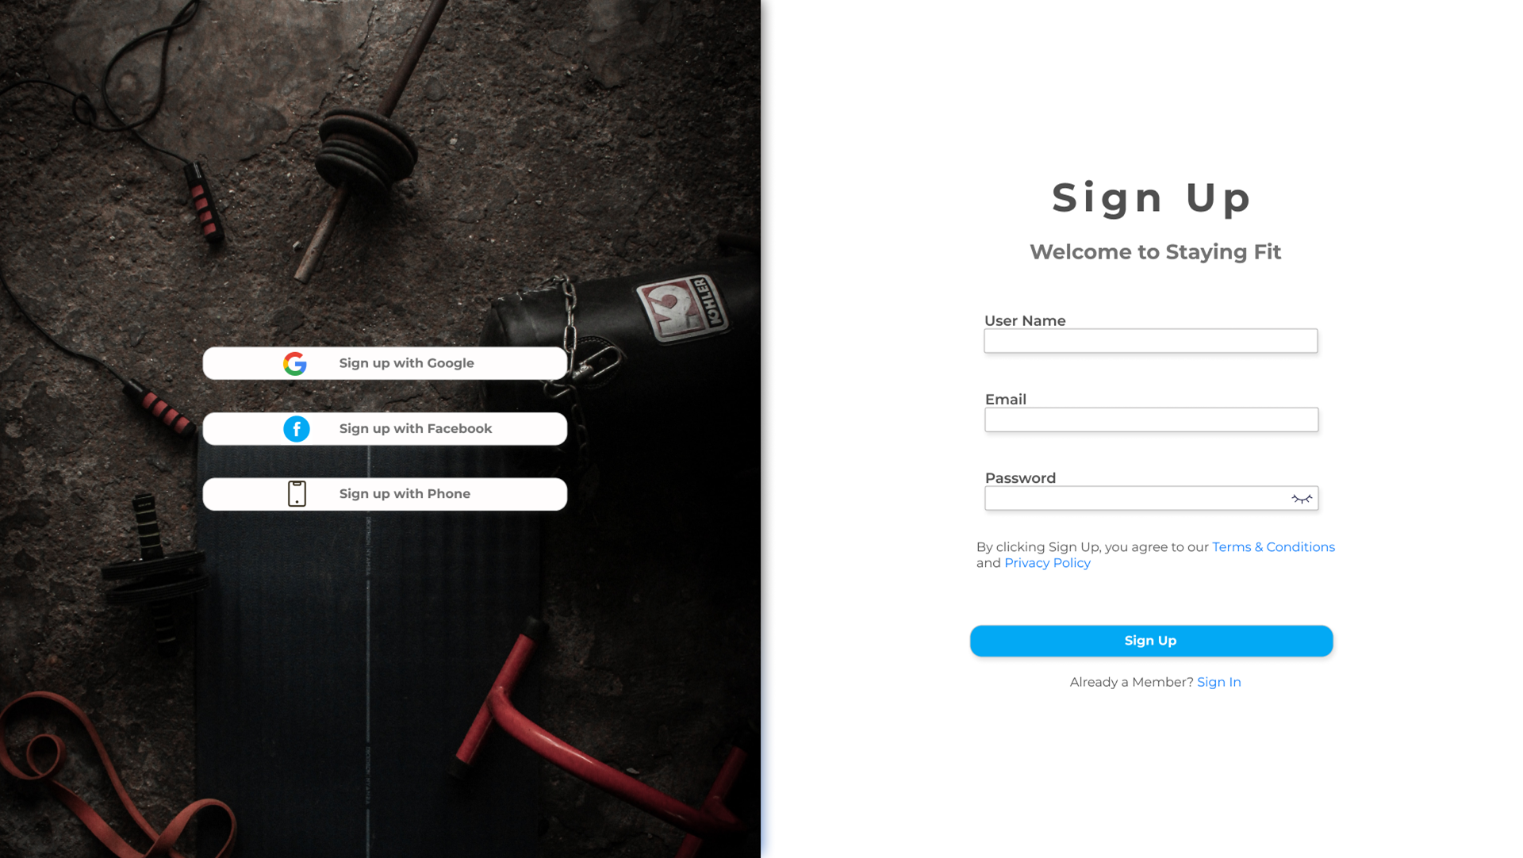

Slide 6
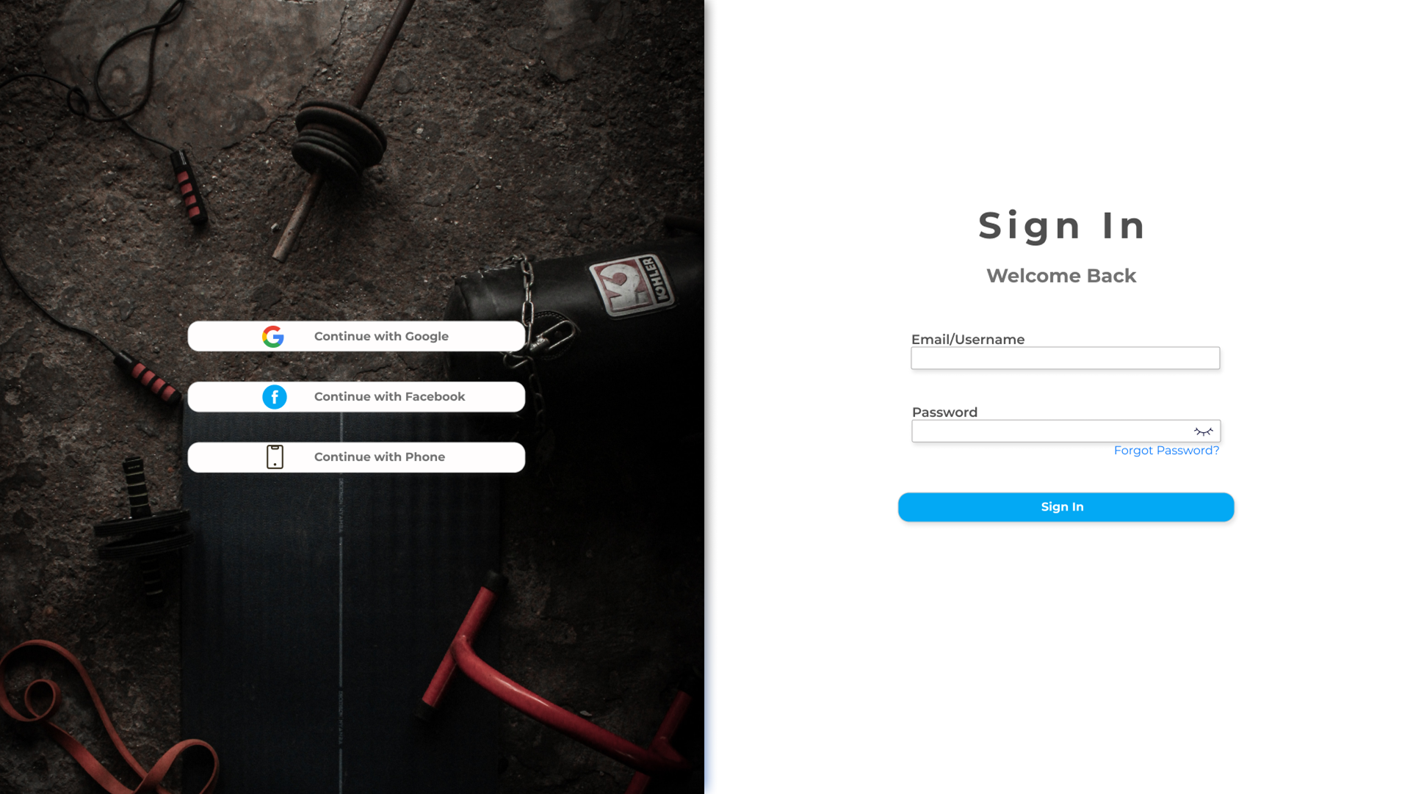

Slide 7
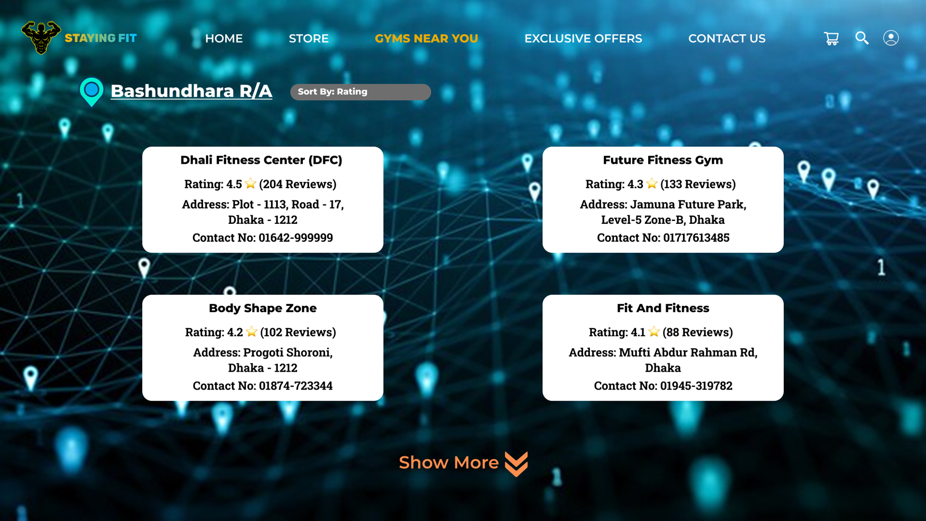

Slide 8
Thank You

